Slide 1
Achieving Success in a Culture of Change Reorganization and the Prospect of Positive Outcomes
Jeff downing, digital projects librarian

Slide 2
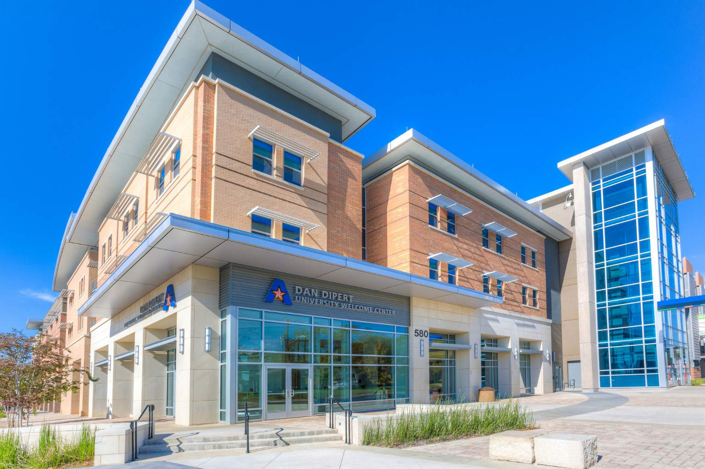
Background: About UTA
Physically located in the heart of the thriving DFW Metroplex, the University’s more than 51,000 students in campus-based and online degree programs represent about 100 countries and pursue more than 180 bachelor’s, master’s, and doctoral degrees in a broad range of disciplines.
Engineering, Nursing and Business are among the largest teaching/research programs.
Thousands of students are virtual

Slide 3
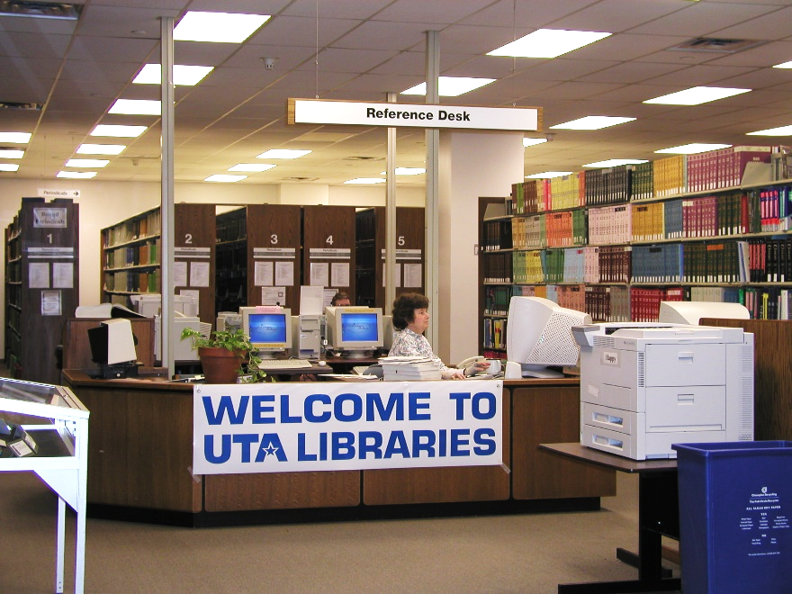
Background: UTA Libraries - Then
Prior to 2013, Library had a traditional service model. Many staff had been in their positions for several years
Public Services – Reference, Subject Liaisons, Circulation, Stacks Management
Technical Services – Collection Development, Acquisitions, Cataloging
Branch Libraries – Architecture/Fine Arts and Science/Engineering
Administration

Slide 4
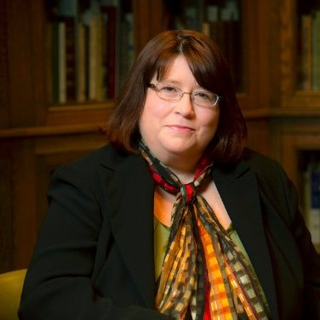
2013 – Library-Wide Reorganization
In Spring 2013, all staff were presented with an opportunity by the Dean to select up to 7 positions for consideration and 3 positions they did not want. Approximately two weeks later, staff received personalized emails from the Dean with information on their new position. A few individuals stayed in their previous positions, but most did not.
By the start of the 2013 Fall Semester, most staff were working 100% in their new positions. Some were already experienced in their new duties, some were not.
The norm was no longer the norm!

Slide 5
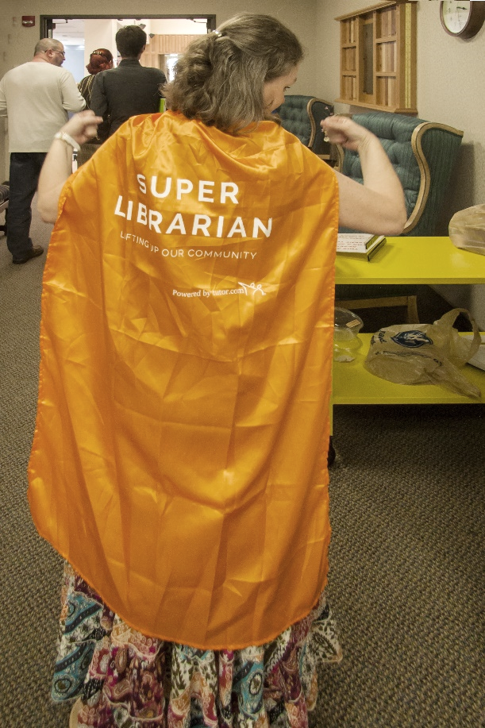
Background: UTA Libraries - Now
It’s all about Student Success
Want to try something new? Ask – how will it benefit students?

Slide 6
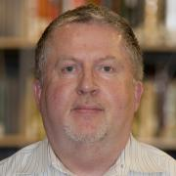
Moving on …
My background includes: Serials acquisitions/cataloging → Library Liaison Officer (Serials training) → Library marketing (regional)→ Retrospection conversion projects manager → Assistant Head of Technical Services → National/international sales and marketing manager → Collection Development
→ Digital Projects Librarian??!
I had many years of experience in traditional technical services operations and also in marketing and sales. But I didn’t know anything about digitization!

Slide 7
What we learned early on
Be OK with:
knowing you don’t know much. Be sure your manager is also OK with your lack of immediate knowledge
a chaotic environment
Learn what’s important to the organization
What are the organization’s priorities?
What are your manager’s priorities?
How can you help them achieve their goals?

Slide 8
What we learned early on
Build internal and external networks
Networks should allow for honest exchanges and learning opportunities
Networks should not be extended pity parties
Achieve some form of success as early as possible
Build confidence in your abilities
Market the success so others will know you are successful
Prove your value to stakeholders
Always have some “gee whiz” numbers on hand
Develop talking points around the success of your project
Have examples of direct impact on student achievement
Seek out opportunities to promote your work

Slide 9
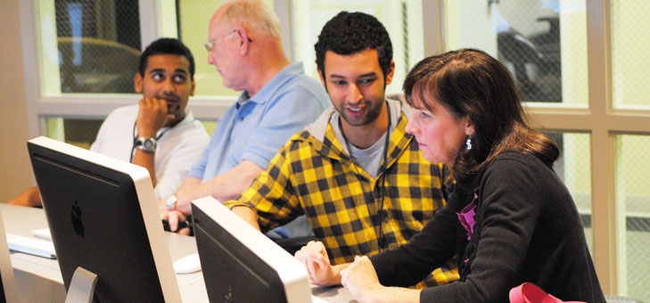
Collaborations between Digital Creation and Special Collections
History of projects involving SPCO and the Digital Library Services departments
Birds and Watchers – Jessie Maye Smith
Tejano Voices
Re-org brought closer ties, deliberate planning and expected outcomes
Two Digital Project Librarians are housed in SPCO
Working groups include staff from both departments and external partners
DC creates online exhibits for all of SPCO’s physical exhibits
Creation of planning team for projects
Play off of strengths, recognize cultural differences

Slide 10
Expectation that grants will fund projects
So we’re getting pretty good at writing grant applications!
Sheet music scanning ($500 Library mini-grant)
Libraries
Texas Disability History Collection ($25k, TexTreasures/LSTA/IMLS)
CoLA, Dept of History, Libraries
Disability History/Archives Consortium and portal ($40k, NEH)
CoLA, Dept of History, Libraries
Borderlands ($10k, CoLA)
Dept of History, Libraries
Through the Lens of the Fort Worth Star-Telegram: A Photographic View of World War II in Fort Worth ($25k, TexTreasures/LSTA/IMLS
Libraries

Slide 11
Maverick Veterans’ Voices
Small collection of oral histories from UTA alums with military ties.
Seed money from COLA administration allowed for professional transcriptions
Lucky to have an experienced working group to conduct interviews and design/develop the site

Slide 12
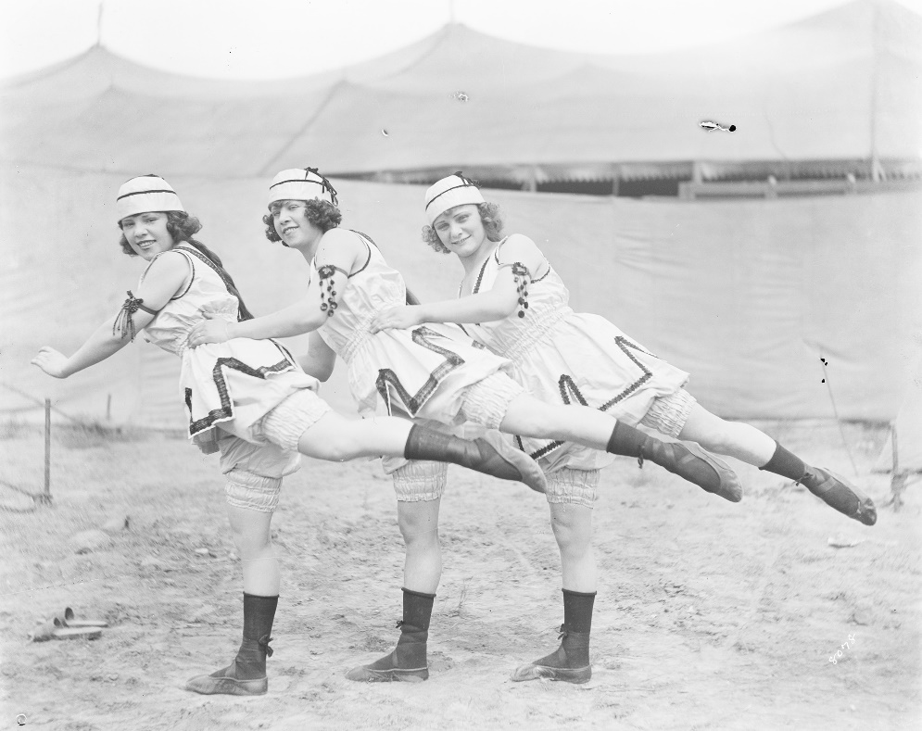
UTA Libraries Digital Gallery
Almost 40,000 images from Special Collections. Adding between 1k and 2k images/month
Fort Worth Star-Telegram World War II images will be included (15k by Aug. 2017)
Is now a “production shop” project
Is also our most popular site, with over 330,000 views since May 2014 launch

Slide 13
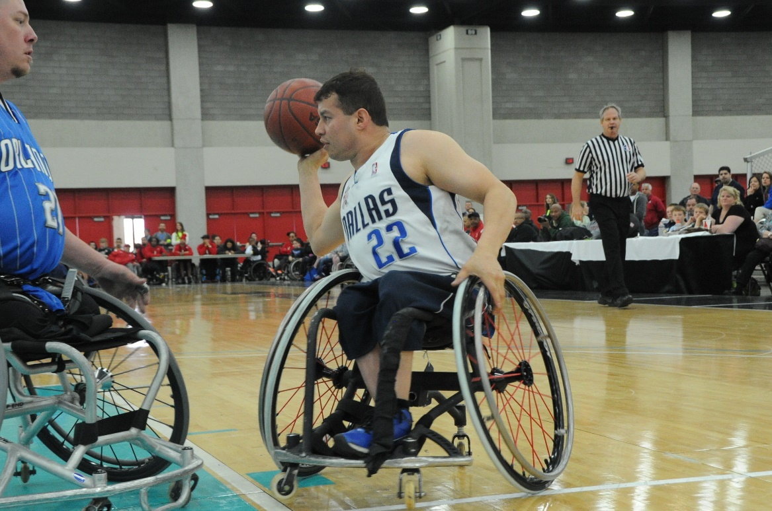
Texas Disability History Collection
Collaborative project with CoLA, Disability History Minor and Libraries
First use of a Memorandum of Understanding
Has the potential to become a regional/national resource
Most complex project to date

Slide 14
Conclusion
The reorganization worked well for many, but not all, Library staff members
There have been a couple of “mini re-orgs”
The Digital Creation and SPCO departments have several success stories to promote
We’ve become (mostly) comfortable and happy with our new business model

