Slide 1
Researcher Impact and Academic Profiles
Alysha Sapp
Texas Christian University
Nursing & Nurse Anesthesia Librarian

Slide 2
Managing a researcher profile is essential to promote that work to others. Many tenure track professors are trying to find ways to stand out and using systems such as ResearcherID, ORCID, Google Scholar Citations, LinkedIn, Mendeley, and Research Gate can help to increase that visibility. The use of these tools is both beneficial and problematic due to the overwhelming amount of options available. This presentation will address the procedure of setting up these profiles, the pros and cons to each of these services, and the promotion of these services to your faculty

Slide 3
Benefits of Creating a Researcher Profile
Differentiates your work
Author identifiers
Common names
Unique number
Grouping
Affiliation changes
Organizations
Institutions
Improves administration for promotion
Improves researcher impact
Unique researcher identity
Biographical information
CV
Improves research impact
Notes:
Differentiate your work from other authors with similar names and especially useful for authors with common names. Author identifiers distinguish between these names by assigning each author a unique number and grouping together all of the documents written by that author.
As you pursue opportunities at different organisations and institutions around the world throughout your career, you can ensure that all of your research outputs are still attributed correctly to you and that your work can be found by others.
Institutions, publishers and funders expect to be able to make use of authors' unique identifiers in their workflows, reducing the amount of repetitive biographical information required when you submit your CV or manuscripts for publication, for example.
Institutions, publishers and funders expect to be able to make use of authors' unique identifiers in their workflows, reducing the amount of repetitive biographical information required when you submit your CV or manuscripts for publication, for example.
The act of collating, organizing and establishing your research will market it through any of the tools mentioned next

Slide 4
Promotion
Tenure committees/Assistant Professors
Adjunct Professors
Associate Professors
Research Fellows
Librarians
Outreach
Notes:
Sitting on the tenure committee for Nursing the last 3 years has made me want to assist assistant professors in reaching their goals. There are many places to promote these types of resources.

Slide 5
Profiles
Search Engines with Author Profiles
Author Identifiers
Google Scholar Citations
Scopus Author Identifier (Elsevier)
ResearcherID (Thomson Reuters Web of Science)
Open Researcher and Contributor ID (ORCID)

Slide 6
Profiles
Social Networks for Researchers
ResearchGate
LinkedIn
Mendeley

Slide 7
Google Scholar Citations
What is it?
For-profit organization
Profile page
Article level citation metrics
Citation metrics are computed and updated automatically
Updates
Notes:
Google Scholar Citations is a persistent author identifier, meant to differentiate between similarly-named authors and to take variant author name spellings and name changes into account.
Google Scholar Citations lets authors set up a profile page that lists their publications and citation metrics.
The citation metrics are updated automatically, and you can choose to have your list of publications updated automatically or update them yourself.
You can make your profile public, so that it appears in Google Scholar results when people search for your name.

Slide 8
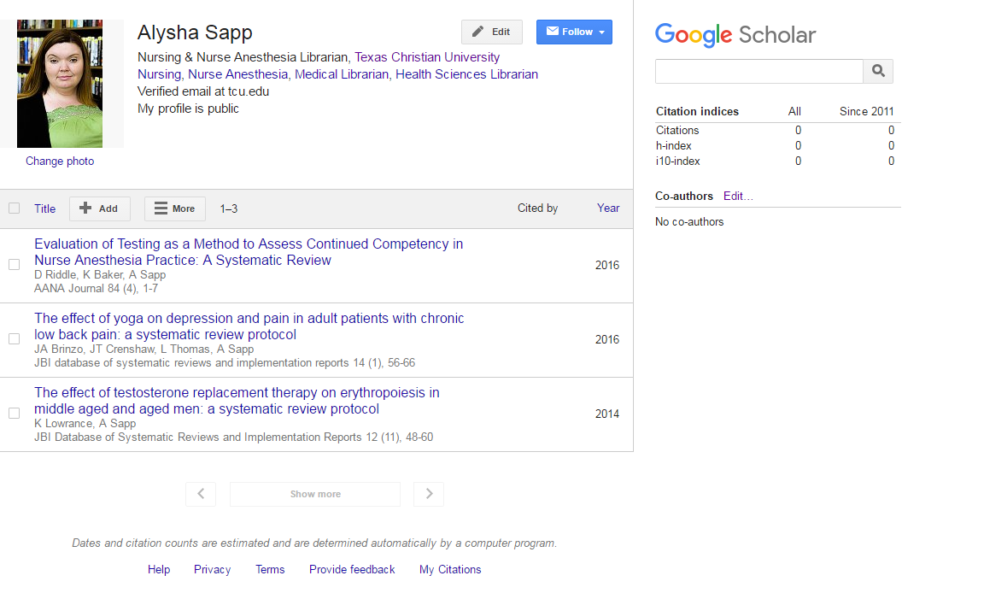
Notes:
Both my articles imported automatically without me having to find them. I have a couple of grey literature items that were not automatically brought in.

Slide 9
Google Scholar Citations: Pros/Cons
Freely available
Editing profile
Citations, h-index and i10-index
Co-authors
Deflated, inflated and phantom counts(Sicilia & Jacso, 2006)
Metrics only cover articles published between 2011 and 2015
Coverage
Grey literature
Discontinuation
Notes:
You can edit and update your profile directly
What can it do for me?
Google Scholar Citations gives you a way to ensure that people searching Google Scholar for your work will find the correct publications attached to your name and access to Google Scholar citation metrics.
Covers a wide range of publications, but…
Coverage is not exhaustive and it is unclear which journals etc. exactly are included in the database
Google tends to review their products periodically and discontinue some products unexpectedly as they did with the very popular Google Reader. Google Scholar and thus Google Scholar Citations might be discontinued in a similar fashion.
You can choose to have your list of articles updated automatically or review the updates yourself, or to manually update your articles at any time.
While Google Scholar Citations is a free product, as is Google Scholar itself, Google is most certainly a for-profit company, which makes the continued existence of Google Scholar and Google Scholar Citations somewhat unpredictable since it is unclear how it is profitable to Google. They might decide to discontinue the service at any time.

Slide 10
Scopus Author Identifier
What is it?
Scopus integration
Author matching and document grouping
Using Scopus Author Identifier
Notes:
Distinguishes between similar author names by assigning each author a in Scopus a unique number and grouping together all of the documents written by that author. Additionally, author names in Scopus can be formatted differently.
To determine which author names should be grouped together under a single identifier number, the Scopus Author Identifier uses an algorithm that matches author names based on their affiliation, address, subject area, source title, dates of publication citations, and co-authors. When you search, this feature returns documents written by that author, even when an author is cited differently.
Scopus Author Identifier helps you to differentiate authors with common last names like Smith or Lee by returning a list of possible author matches with their affiliations and subject areas of interest. Scopus Author Identifier also helps you find authors who have been cited differently. When grouping author names under a unique author identifier number, Scopus takes into consideration last name variations, all possible combinations of first and last names, and the author name with and without initials. As a result, searches for a specific author include a preferred name and variants of the preferred name.

Slide 11
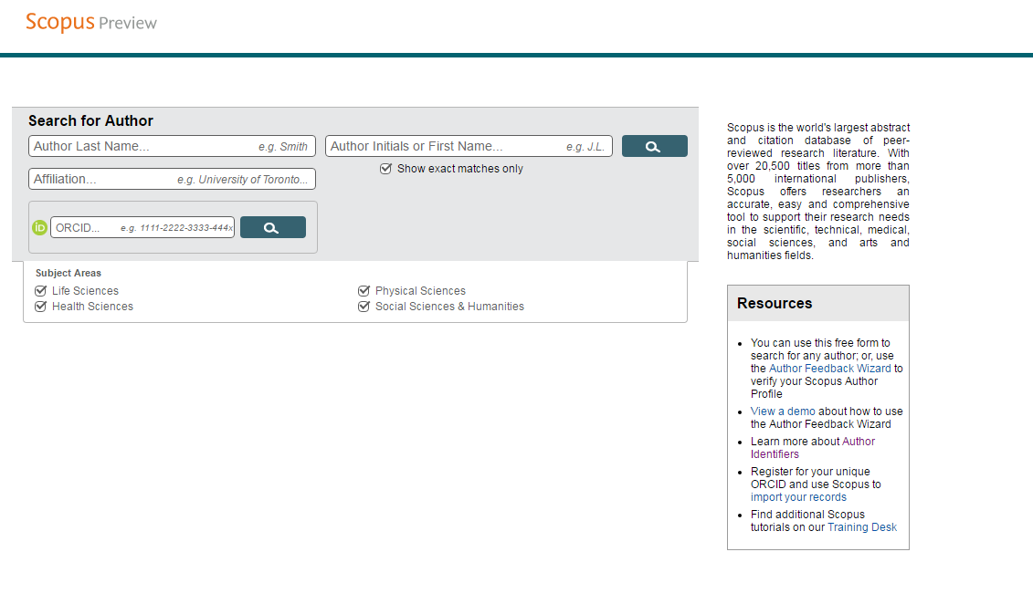

Slide 12
Scopus Author Identifier: Pros/Cons
Inaccessible without a subscription
Can connect using ORCID
Check and correct
You have been assigned a single Scopus Author Identifier,
All your publications have been assigned your Author ID, and
Your Scopus author profile details are correct.
Management of the information included on the ID profile page
The Pros and Cons of Computing the h-index using Scopus (Péter, 2008)
Notes:
Scopus uses an algorithm to determine which identifiers should be assigned to author names, however it sometimes makes mistakes.
You can't actually manage the information included on the ID profile page yourself.

Slide 13
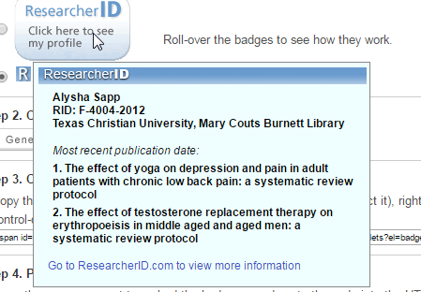
ResearcherID
What is it?
Web of Science integration
Badges:
Notes:
ResearcherID provides a solution to the author ambiguity problem within the scholarly research community. Each member is assigned a unique identifier to enable researchers to manage their publication lists, track their times cited counts and h-index, identify potential collaborators and avoid author misidentification. In addition, your ResearcherID information integrates with the Web of Science and is ORCID compliant, allowing you to claim and showcase your publications from a single one account. Search the registry to find collaborators, review publication lists and explore how research is used around the world!

Slide 14
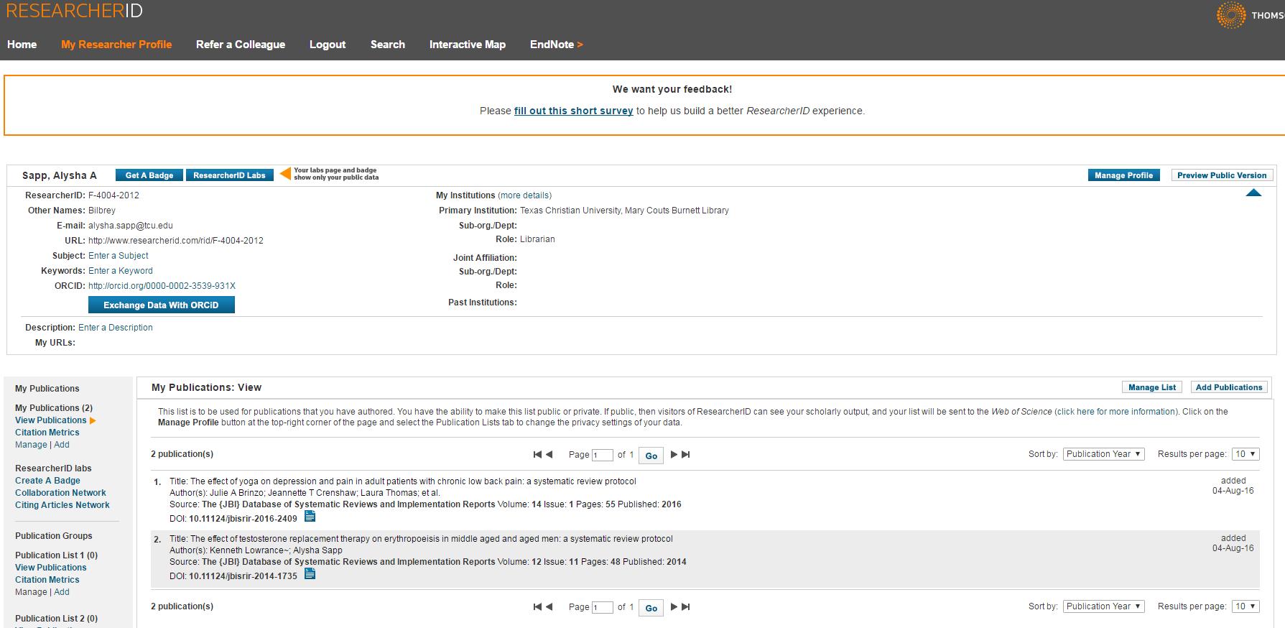

Slide 15
ResearcherID: Pros/Cons
Freely available: http://www.researcherid.com/SelfRegistration.action?utm_source=false&utm_medium=false&utm_campaign=false
Badges
ResearcherID Labs
Public/Private
Detailed citation reports, collaboration networks and citing article networks available
Add only journals
Citation metrics
Citations & ORCID
Notes:
ResearcherID itself is a free service, though further use of Web of Science is contingent on your institution having access to Web of Science.
through the ResearcherID Labs you can create visual Collaboration Networks and Citing Articles Networks created from Web of Science data
Like ORCID you can determine what information about you is public or private, but it seems as if the level of control is less granular than that of ORCID.
Citation metrics are derived solely from the Web of Science Core collections so they aren’t exhaustive
Unlike the ORCID, ResearcherID only allows you to add journal articles to the list, so any other research output is excluded

Slide 16
ORCID
What is it?
Non-profit organization
Integration
Notes:
ORCID provides an identifier for individuals to use with their name as they engage in research, scholarship, and innovation activities. ORCID is freely available to every individual researcher, who can claim their ID, keep their information current and manage their record of activities, whether these activities are publishing a new article, making your data available on Figshare, or whether it is a presentation--ORCID supports over thirty different expressions of scholarly activity. It is run by a board composed of members drawn from universities, publishers, and funding organizations.

Slide 17
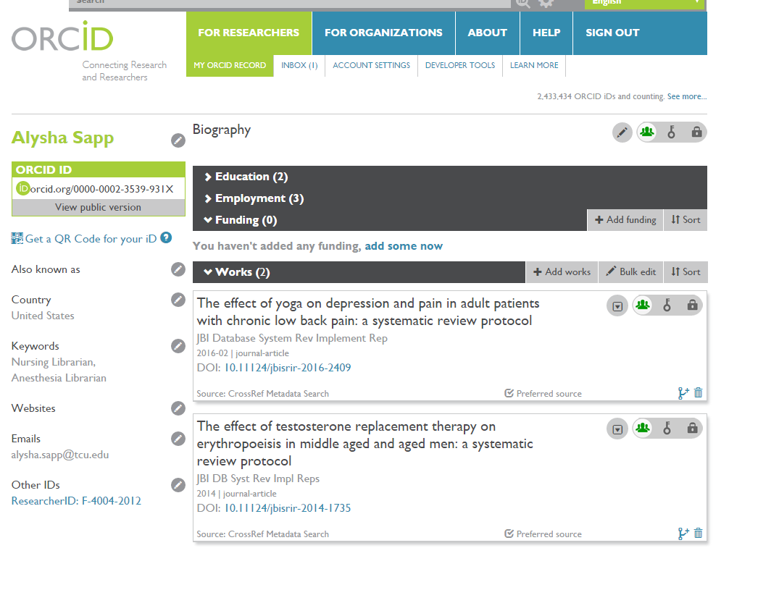

Slide 18
ORCID: Pros/Cons
Independent organization
Integration with other identifiers and other services
Good privacy controls
Updates and upkeep
Notes:
ORCID has a solid Privacy Policy on their website and as far as I've been able to find there aren't any concerns beyond the usual caveats. In addition, ORCID provides a very granular level of privacy controls, allowing the user to display as much, or as little, as they want.
Authors have to update and upkeep everything themselves and make sure the update all the other services after you’ve updated ORCID…it’s kind of exhausting!

Slide 19
Research Gate
What is it?
Recommendations
Affiliations
Linked In
Follows
Notes:
ResearchGate is a social network for academics. Similar to Facebook, Twitter, and LinkedIn, ResearchGate mixes the three together to create a network to connect researchers and their research, however, only researchers connected to an academic institution are able to register. After registration you'll be able to create a profile which displays your education, your expertise, your publications, your interests, and your contact details among other things
Recommendations can be random for a librarian, dependent upon searches I’ve done in the past, and completely unrelated to my own area of interest.
Unlike Facebook you cannot control your friends. It’s more like a business page where individuals can like and follow your work.

Slide 20
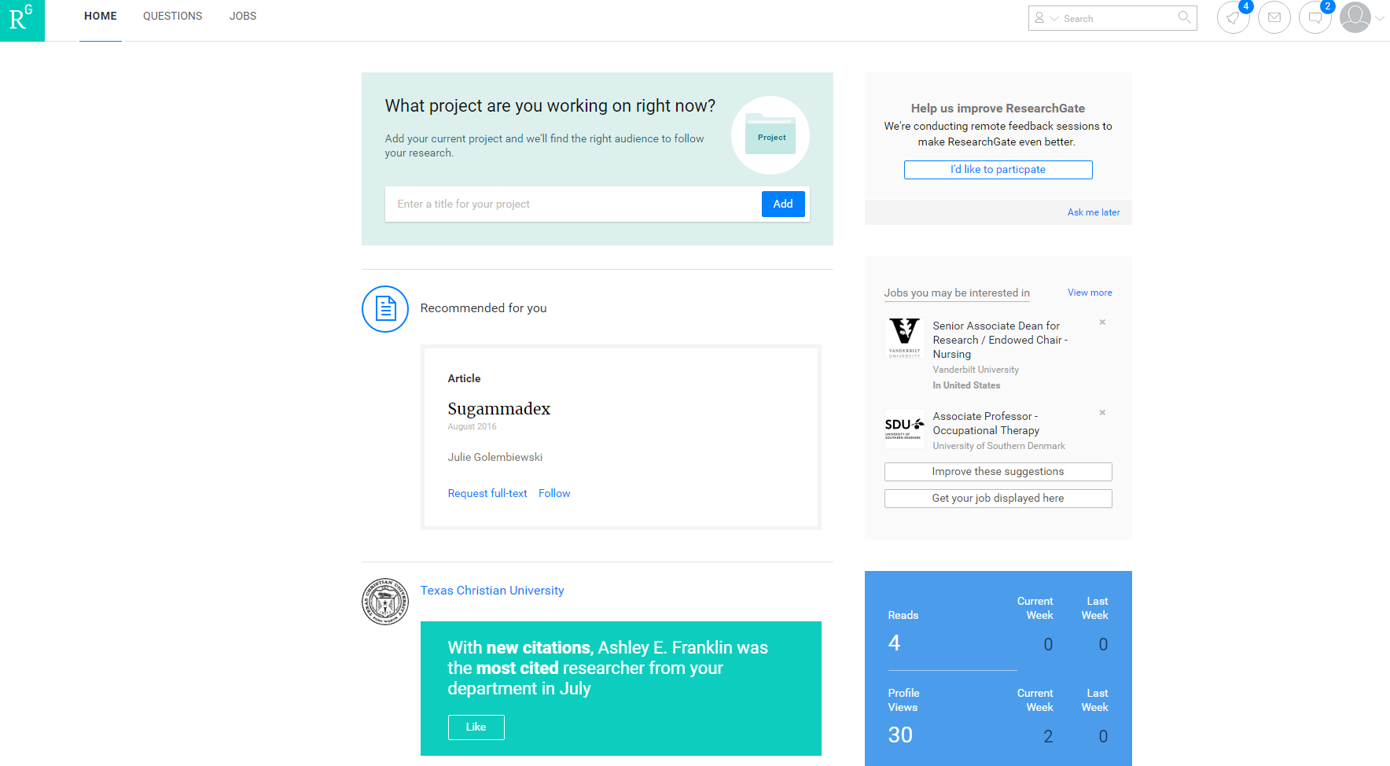

Slide 21
Research Gate: Pros/Cons
Free
Connect to peers
Easy access to publications of interest
Ask questions
Number of members is unclear
Membership is required
Requires an academic affiliation
Most of the membership is medicine and science
Legality
Story
Notes:
Connect to a large network of your peers
Membership is a requirement to see anything other than people's profile pages
When a researcher puts their full text article in research gate, and someone access and cites from research gate, research gate gets publication credit not the publisher, which hurts the publisher’s impact factor. This is being discussed at nursing/medical conferences.

Slide 22
LinkedIn
What is it?
Personalization
Linking to colleagues or other professionals
Free vs. Premium membership
More than employment opportunities…
Privacy
Notes:
LinkedIn is a professional networking site mostly focused on a corporate or commercial audience. For many people LinkedIn functions as an online CV and as a way to keep up with previous co-workers or to discover new career opportunities.
If LinkedIn is so much more focused on finding employment opportunities and recruiting, how can it benefit the academic career? It can create visibility beyond academia and allow you to network with fellow researchers.
The usual caveats to privacy on social media apply, but LinkedIn privacy settings can be tricky to navigate and if not set correctly can result in embarrassing situations

Slide 23
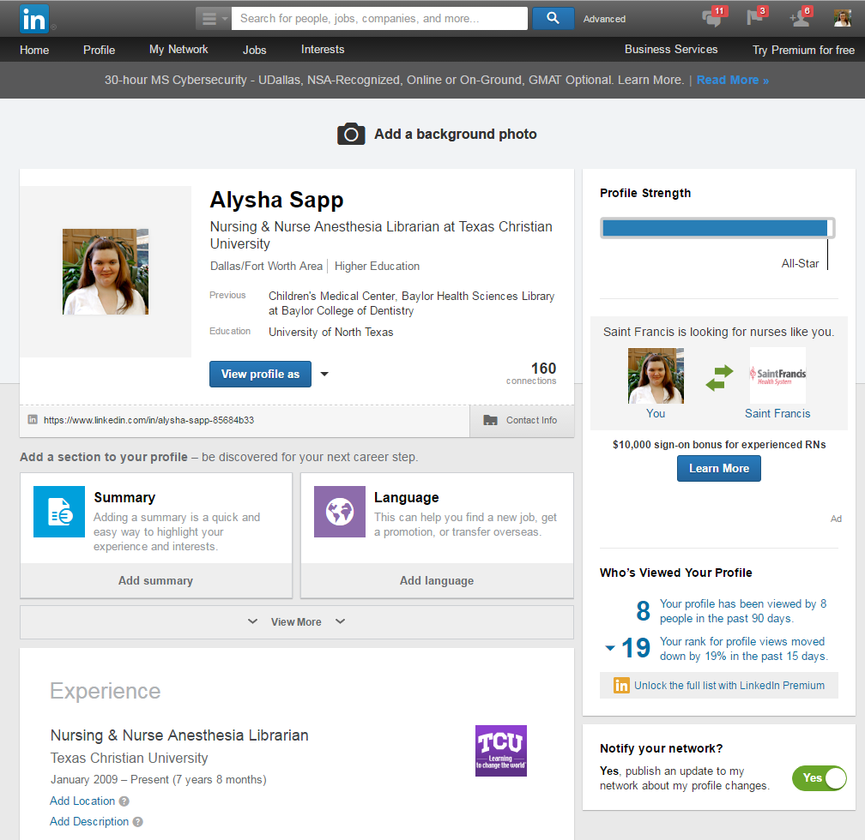

Slide 24
LinkedIn: Pros/Cons
Central professional profile
Greater visibility
Free membership
Professional contacts
Prior employment
Business oriented
Pressure to buy premium membership
Notes:
Greater visibility due to LinkedIn’s ranking on Google

Slide 25
Mendeley
What is it?
Why is it included?
Platforms and devices
Privacy
Notes:
Mendeley is a social reference manager. This means that you can use it to track your references and manage how they appear in your paper's bibliography, much like the traditional reference managers such as EndNote or RefWorks, but you can also use it to share recommendations, notes and even articles with your peers in research groups.
Mendeley is a free reference manager service, that will allow you to use it across platforms and devices. Since it's free, you won't lose any data if you move to a different place of employment, which might use different institutional software.
Mendeley collects all the usual data you provide plus they collect information on what you search and read to improve their recommendations to you.

Slide 26
Mendeley: Pros/Cons
Free
Platform-agnostic
Easy to use
Bought by Elsevier in 2013
No “cite while you write” with Apple software
Legality
Notes:
Legality of sharing some of the copyrighted materials on the site is questionable

Slide 27
Other Sites
Academia.edu
Blog
Facebook
Twitter
Zotero
Tumblr
Figshare
Pinterest
Storify
CiteULike
Kudos
…and more!

Slide 28
Citations
Péter, J. (2008). The pros and cons of computing the h‐index using Scopus. Online Information Review, 32(4), 524-535. doi:10.1108/14684520810897403
Sicilia, M.-A., & Jacso, P. (2006). Deflated, inflated and phantom citation counts. Online information review, 30(3), 297-309.

Slide 29
Questions?
Contact Information:
Alysha Sapp
Alysha.sapp@tcu.edu

