Slide 1
Open Educational Resources Programming That Has Excited Co‐Workers And Patrons
Kris Helge Ph.D., J.D.
Director of library services
Tarrant county college, nw campus

Slide 2
What we have done
Cc by http://guides.lib.uw.edu/oer

Slide 3
Disseminate surveys

Slide 4
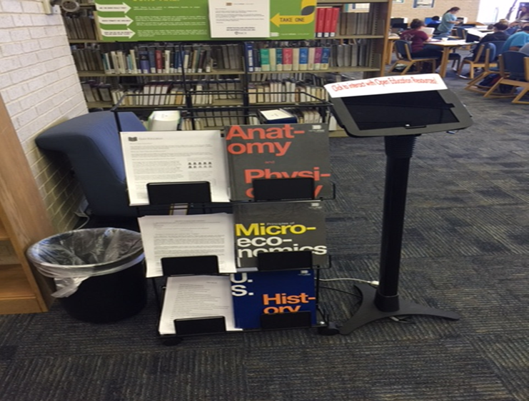
Interactive print and digital displays
Surface pro
links
Handouts
Links
Fair use
sparc

Slide 5
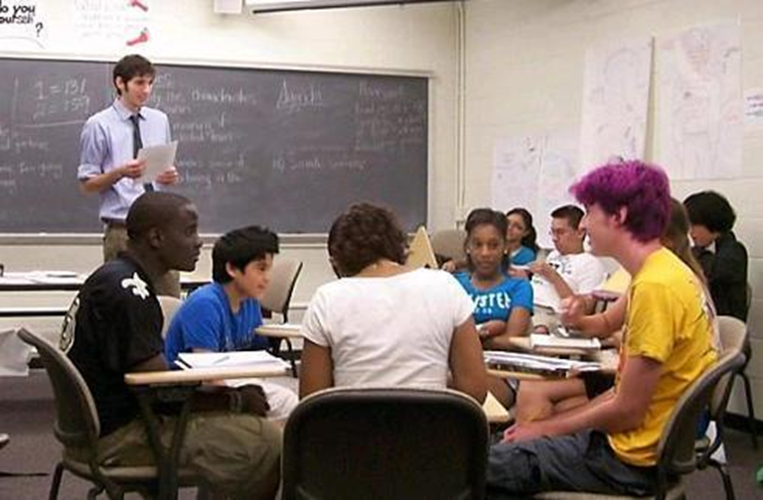
Targeted classroom and department outreach
Cc by https://brown.digication.com/ejmiller/Discussion

Slide 6
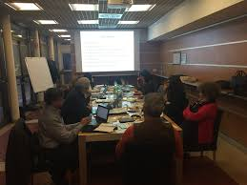
Oer special interest group
Meet at least twice a semester
Webinars
Specific oer providers
Evaluate specific vendors
Specific oer for certain substantive areas
Copyright
Creative commons licenses
Policy issues
Lunch!!
CC BY http://eustore.eduproject.eu/

Slide 7
Faculty panels and one-on-one consultations

Slide 8
Get your geek on oer, cc, copyright event
CC by http://www.autumnbench.com/how-to-look-like-a-geek-how-to-act-like-a-geek/

Slide 9
TCC OER degree
Cc by http://today.uconn.edu/2015/12/law-school-announces-new-intellectual-property-law-degree/

Slide 10
Success and challenges
Success
Events broach new content
22 instructors experimenting with oer
Students now asking for oer
Cost
Surveys
Capitalize off of the point of need
challenges
Attendance
Confusion about what oer is???
bookstore
Change
policy

Slide 11
conclusions

Slide 12
Questions
Kris helge
Kristyn.helge@tccd.edu

