Slide 1
Standardizing Quality Control of Images
Shannon Willis, University of North Texas Libraries Digital Project Unit

Slide 2
At UNT
Thousands of images from partners
Evaluate to ensure standards are met

Slide 3
Problem
Subjective
Many hands in the pot

Slide 4
Step 1: Break it Down
1. File type
2. File names
3. Resolution
4. Bit depth
5. Color space
6. Color
7. Color issues
8. Skew
9. Rotation
10. Borders
11. Edges
12. Backs

Slide 5
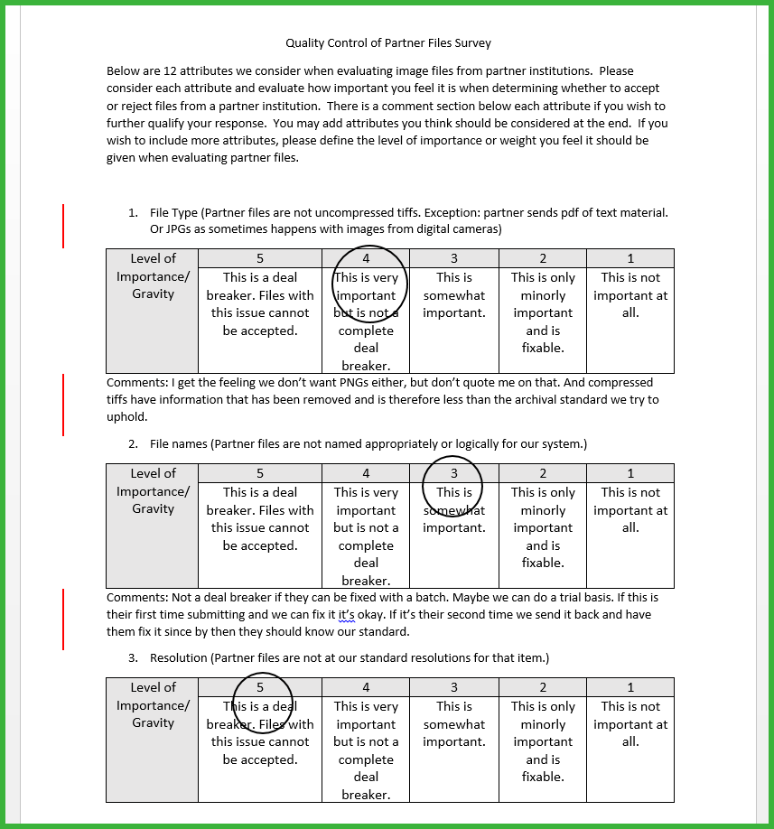
Step 2: Survey Staff

Slide 6
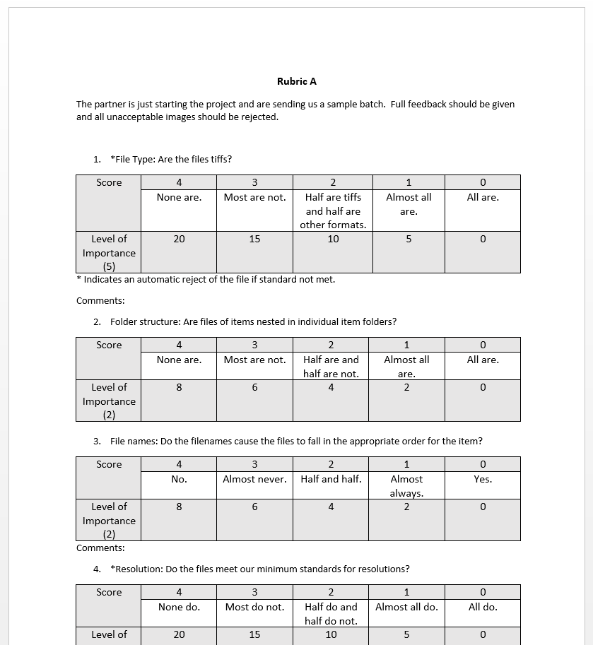
Step 3: Create Guide and Rubrics

Slide 7
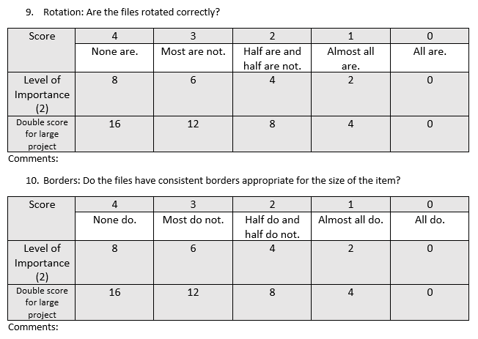
Key Features
Status of project matters
Size of project matters

Slide 8
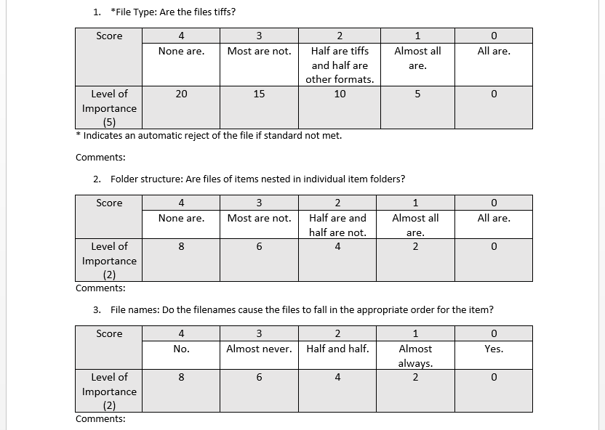
How to use

Slide 9
Purpose
Training
Guide

Slide 10
Thank you

