Slide 1
Applying the ACRL Framework
In the Real World
Megan Heuer
Southern Methodist University

Slide 2
Reactions to the new Framework

Slide 3
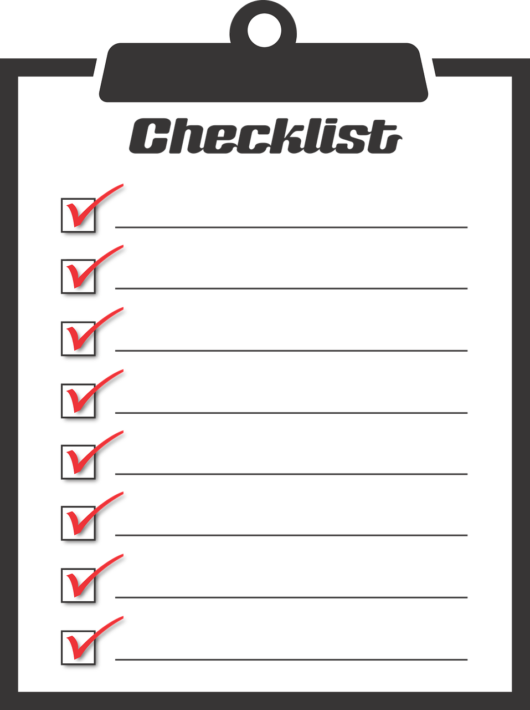
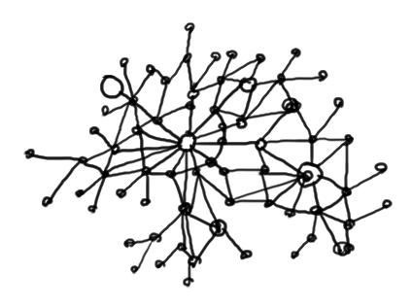
Differences in the documents impact our teaching
Standards
Framework
Process oriented
Describes what you do
IL as a discretely definable skill
Concept oriented
Describes what you know
IL as socially constructed

Slide 4
Why teach big concepts?
Encouraging expert problem solving
“Alicia Martin's Books Cascade” by Inhabit is licensed CC 2.0

Slide 5
High road transfer and bridging

Slide 6
The Framework in action
“Frames” by Jordan Richmond is licensed CC 2.0

Slide 7
Progressive Learning Outcomes
Program objective:
Recognize how and why information is produced and valued
Learning outcome:
Identify the uses, advantages, disadvantages, specificity, and means of access for various business, consumer, and media information sources
Learning outcome:
Match research needs to potential information sources
Learning outcome:
Identify the limitations of information for advertising and analyze how that impacts research
Disciplinary objective:
Recognize how and why information in the field of advertising is produced and valued
Learning outcome:
Determine perceived industry value of specific information source types

Slide 8
Source comparison chart
Source Type | How to find | Essential characteristics | Advantages/ Disadvantages | Intended audience | Possible uses
Newspaper articles
Company profiles
Industry profiles
Market research reports
Trade magazine articles
Professional association reports
Scholarly articles
Consumer surveys
Company reports
Other?

Slide 9
Problem-based case studies
Dallas Area Rapid Transit
Dallas Area Rapid Transit has been losing ridership recently and is looking at revamping their advertising. Given that people in Dallas like their cars, they are aware of the challenges of promoting public transportation. Your agency has been hired to develop a campaign.
For your secondary research, you will need to find:
Preferences, attitudes, demographics, segments of their target market
Identification of key competitors
Industry trends
Recommendations for media placement
Form 10-K and Annual Reports
Public companies, or companies that sell stock, are required by the government to provide information to the government and to stockholders. This reporting is done through the Form 10-K and includes a comprehensive overview of the company and its financials. Companies also provide an annual report to stockholders. If a company only operates within a single state, it is only required to report to the state government. Private companies do not need to report anything publicly.
Information from the Form 10-K is often used to provide financial information in company profiles, directories, etc.

Slide 10
Research deconstruction

Slide 11
Means of Assessment
Authentic assessment for conceptual understanding
Direct and indirect
“Expert” by Pete Prodoehl is licensed CC 2.0

Slide 12
Questions?
mheuer@smu.edu
@MeganBHeuer
www.smu.edu/infolit for all program objectives and example learning outcomes

Slide 13
Example rubric for case studies
Learning outcome: Identify the limitations of information on companies, industries, markets, and consumers
Learning outcome: Match research needs to potential information sources
Criteria | Exemplary (3) | Proficient (2) | Emerging (1) | Little or No Evidence (0)
Recognition of connection between information search and the information creation process | Recognized limitations of different types of information and restructured research accordingly. Articulated well how this might impact future research projects. | Recognized some limitations of different types of information and restructured research sometimes. Limited understanding of how this might impact future research. | Recognized few limitations of different types of information. May not have restructured research successfully. No understanding of the impact on future research. | Did not consider the information creation process in conducting research.

Slide 14
References
Difference in the documents
Fister, B. (2015). The information literacy standards/framework debate. Retrieved from https://www.insidehighered.com/blogs/library-babel-fish/information-literacy-standardsframework-debate
Foasberg, N. M. (2015). From standards to frameworks for IL: How the ACRL framework addresses critiques of the standards. Portal: Libraries and the Academy,15(4), 699-717. Retrieved from https://muse.jhu.edu/article/595062
Research as problem solving
Zimmerman, B. J., & Campillo, M. (2003). Motivating self-regulated problem solvers. In J. E. Davidson, & R. J. Sternberg (Eds.), The psychology of problem solving (pp. 233-262). GB: Cambridge University Press - M.U.A.
High road transfer and bridging
Bransford, J. D. (2001). How people learn (Expanded ed., 4. print. ed.). Washington, D.C: National Acad. Press.
Kuglitsch, R. Z. (2015). Teaching for transfer: Reconciling the framework with disciplinary information literacy. Portal (Baltimore, Md.), 15(3), 470; 470.
Assessment
Maki, P. (2010). Assessing for learning (2. ed. ed.). Sterling, Va: Stylus Publ.
Oakleaf, M. (2014). A roadmap for assessing student learning using the new framework for information literacy for higher education. The Journal of Academic Librarianship, 40(5), 510-514. doi:10.1016/j.acalib.2014.08.001

